Slide 1
Complex Custom Clinical Graphs Step by Step with SAS® ODS Statistical Graphics
Richann Watson is an independent statistical programmer and CDISC consultant based in Ohio who loves to code and is very active in the SAS User Group community. When Richann is not busy coding or volunteering in the SAS User Group community, she is spending time with her family and cute but psycho puppy, Loki, or doing some of her favorite crafts such as crocheting or sewing.
Josh Horstman is an independent statistical programming consultant and trainer based in Indianapolis with 25 years of experience using SAS, primarily in the life sciences industry. Josh is a SAS Certified Advanced Programmer who loves coding and presenting at PharmaSUG and other industry conferences. Josh also enjoys travelling and hiking with his family and has been to 47 states and 27 national parks.

Slide 2
Agenda
Create a Basic Bar Chart
SGPLOT
GTL
Add Titles and Footnotes to Graph Area
SGPLOT
GTL
Embedding a Table Within a Graph
SGPLOT
GTL
Adding a Table Outside the Graph
SGPLOT
GTL

Slide 3
Creating a Simple Bar Chart

Slide 4
Understanding Drawspace
Images taken from SAS® Graphics for Clinical Trials by Example written by Kriss Harris and Richann Watson
Notes:
Data area is the portion of the graph where the plot is displayed. Most graphs have a data area with the exception of graphs that do not have axes (e.g., pie charts).
ANIMA1: The area up to the axes is not included in the data area. This small piece is part of the wall area. The wall is bound by the 4 axes: X, X2, Y and Y2. Similar to data area, if there are no axes, then there is no wall area.
ANIMA2: Next, we have the layout area, this area encompasses the wall area as well as the axes, tick marks, labels and legends. This is all the information that is specified within the LAYOUT, which will be discussed in a bit.
ANIMA3: The last area is the graph area, and this encompasses the entire graph even titles and footnotes that are embedded directly within the graph above/below the layout.

Slide 5
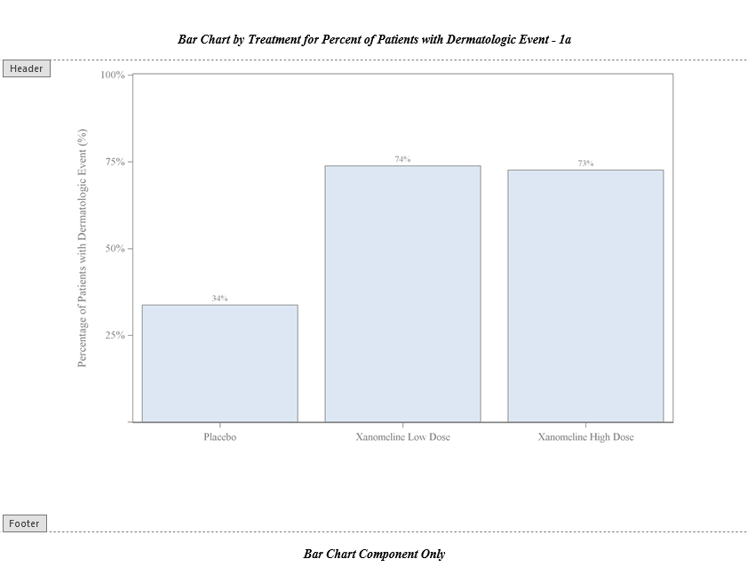
Step 1: Creating a Simple Bar Chart
Notes:
When the graph is written to the RTF destination, the titles and footnotes are in the system header/footer section of the document.

Slide 6
Exercise 1a - Using SGPLOT
title "Bar Chart by Treatment for Percent of Patients with Dermatologic Event - &pgmname";
footnote "SGPLOT - Bar Chart Component Only";
proc sgplot data = OUTD.TRTPCT;
format TRTAN trt. PCT_ROW pctfmt.;
xaxis type = discrete label = " ";
yaxis type = linear
label = "Percentage of Patients with Dermatologic Event (%)"
values = (0 to 100 by 25);
vbar TRTAN / response = PCT_ROW datalabel = PCT_ROW;
run;
Notes:
Josh
<< Open Exercise 1a – Enter the plot statement to create a vertical bar chart and display the values >>

Slide 7
Understanding GTL
Define the structure of the graph.
The template name is used when rendering the graph.
proc template;
define statgraph recrgrphb;
begingraph / border = false;
layout overlay / xaxisopts = (label = " " type = discrete)
yaxisopts = (label = "Percentage of Patients with Dermatologic Event (%)"
linearopts = (tickvaluesequence = (start = 0 end = 100
increment = 25)
viewmax = 100));
barchart x = TRTAN y = PCT_ROW / orient = vertical
barlabel = true;
endlayout;
endgraph;
end;
run;
Define statement has a corresponding END.
Notes:
Richann
Before we can create a template, we need to understand the different components.
Every graph template starts with DEFINE STATGRAPH and ends with END. This is our template sandwich. Everything in between are the goodies. We have to give our template a name so that when we render it we can associate the correct template with the data.

Slide 8
Understanding GTL
Each STATGRAPH has at most one BEGINGRAPH, which signals the start of the graph template definition.
proc template;
define statgraph recrgrphb;
begingraph / border = false;
layout overlay / xaxisopts = (label = " " type = discrete)
yaxisopts = (label = "Percentage of Patients with Dermatologic Event (%)"
linearopts = (tickvaluesequence = (start = 0 end = 100
increment = 25)
viewmax = 100));
barchart x = TRTAN y = PCT_ROW / orient = vertical
barlabel = true;
endlayout;
endgraph;
end;
run;
BEGINGRAPH has a corresponding ENDGRAPH, which signals the end of the graph template definition.
Notes:
Richann
Within the definition, we create another layer. This layer begins with BEGINGRAPH and ends with ENDGRAPH. There is at most one BEGINGRAPH within STATGRAPH. This signals the start of the various components that will be used to be create a custom template. ENDGRAPH signals the end of the graph template definition.
BEGINGRAPH has several different options that can be used to control walls, borders, colors, axis breaks as well as other features. In this example, we illustrate the removal of the border around the graph.

Slide 9
Understanding GTL
proc template;
define statgraph recrgrphb;
begingraph / border = false;
layout overlay / xaxisopts = (label = " " type = discrete)
yaxisopts = (label = "Percentage of Patients with Dermatologic Event (%)"
linearopts = (tickvaluesequence = (start = 0 end = 100
increment = 25)
viewmax = 100));
barchart x = TRTAN y = PCT_ROW / orient = vertical
barlabel = true;
endlayout;
endgraph;
end;
run;
LAYOUT allows you to specify the type of layout. Some layouts can be nested.
For each LAYOUT, you need to signal the end of the layout with ENDLAYOUT.
Notes:
Richann
LAYOUT allows you to specify the type of layout you want and assign the necessary options. There are different layouts: OVERLAY, GRIDDED, LATTICE, DATAPANEL, DATALATTICE, as well as several others.
Layouts can be nested depending on whether LATTICE, GRIDDED, DATAPANEL or DATALATTICE is used. For each LAYOUT, you need to signal the end of the layout with ENDLAYOUT. LAYOUTs have their own options that help to control AXIS (X, X2, Y or Y2). What type of data, such as LINEAR. Depending on the type of data, there are specific options for that as seen here. We have linear data, so we use the LINEAROPTS to nest the options associated with linear data.

Slide 10
Exercise 1b - Using GTL
proc template;
define statgraph recrgrphb;
begingraph / border = false;
layout overlay / xaxisopts = (label = " " type = discrete)
yaxisopts = (label = "Percentage of Patients with Dermatologic Event (%)"
linearopts = (tickvaluesequence = (start = 0 end = 100
increment = 25)
viewmax = 100));
barchart x = TRTAN y = PCT_ROW / orient = vertical
barlabel = true;
endlayout;
endgraph;
end;
run;
Specify the plot statement within the OVERLAY layout.
Each plot statement will have their own set of options.
Notes:
Richann
The majority of the work will take place within the LAYOUT block(s). Depending on the type of layout(s) and plot(s) will drive how this portion is programmed. If there are multiple layouts or nested layouts, then there needs to be a corresponding ENDLAYOUT for each. As many plot statements and their corresponding options needed to build the graph should be encompassed within the corresponding LAYOUT.
The options associated with the bar chart specifies that the bars should be vertical rather than horizontal. In addition, each bar is to be labelled with the value.
<< Open Exercise 1b – let’s enter the plot statement to create a vertical bar chart. We want the bars to have the values as well >>

Slide 11
Exercise 1b - Using GTL
title "Bar Chart by Treatment for Percent of Patients with Dermatologic Event - &pgmname";
footnote "GTL - Bar Chart Component Only";
proc template;
…
run;
proc sgrender data = OUTD.TRTPCT template = recrgrphb;
format TRTAN trt. PCT_ROW pctfmt.;
run;
Using SGENDER you can specify the data that will be used with the template that was defined.
Notes:
Richann
Now that you have created your template, you need to render it by associating the data with it.
Once the template is defined you can associate any data with it as long as the components (i.e., variables) defined in the template reside in the data set.
With PROC SGRENDER, you can use other SAS statements such
By statement
Format statement
Label statement.
The use of a format statement could help to maintain a specific order in the data. The label statement could be used to define the x and y-axis if the labels were not pre-defined in the template. This could be beneficial if the template is used for producing multiple outputs but with different x and y-axis labels. The by statement will allow the template to be rendered by groups.
<< Continue Exercise 1b – enter the name of the data set OUTD.TRTPCT and the name of the template that you just finished completing with the addition of the plot statement >>

Slide 12
Titles and Footnotes
in Graph Area

Slide 13
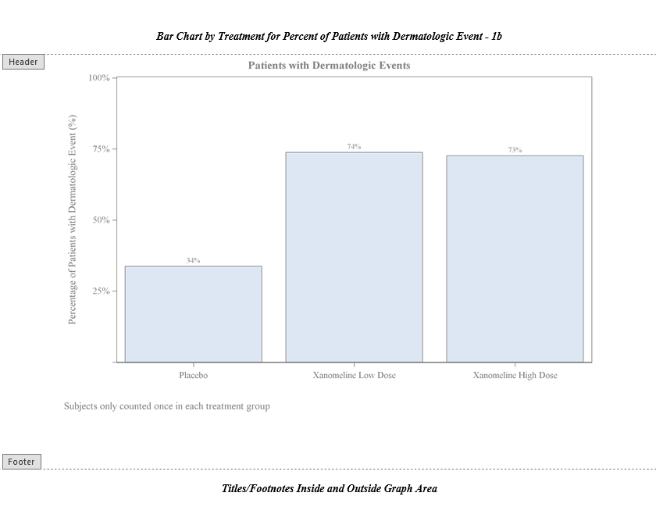
Step 2: Titles and Footnotes in Graph Area
Notes:
Josh

Slide 14
Using SGPLOT Create Annotate Data Set
data insidetf;
retain function 'text' drawspace 'graphpercent' width 100;
length anchor $6 textstyleelement $17 label $51;
input x1 y1 anchor $ textstyleelement $ label $ 32 - 82;
cards;
50 99 top GraphTitleText Patients with Dermatologic Events
20 1 bottom GraphFootnoteText Subjects only counted once in each treatment group.
;
run;
Notes:
Josh
<< might need to explain different pieces of the annotate data set … e.g., function and the different options tied to a function, anchor, etc. >>

Slide 15
Exercise 2a - Using SGPLOT SGANNO
title "Bar Chart by Treatment for Percent of Patients with Dermatologic Event - &pgmname";
footnote "SGPLOT - Titles/Footnotes Inside and Outside Graph Area";
proc sgplot data = OUTD.TRTPCT
pad = (top = 5% bottom = 5%) sganno = insidetf;
format TRTAN trt. PCT_ROW pctfmt.;
xaxis type = discrete label = " ";
yaxis type = linear label = "Percentage of Patients with Dermatologic Event (%)"
values = (0 to 100 by 25);
vbar TRTAN / response = PCT_ROW
datalabel = PCT_ROW;
run;
Notes:
Josh
<< Open Exercise2a – enter options that will use the annotate data set as well as put a 5% buffer at the top and the bottom of the graph >>

Slide 16
Exercise 2b - Using GTL ENTRYTITLE/ENTRYFOOTNOTE
proc template;
define statgraph recrgrphb;
begingraph / border = false;
entrytitle "Patients with Dermatologic Events";
entryfootnote halign = left "Subjects only counted once in each treatment group.";
layout overlay / /* axis options */;
barchart x = TRTAN y = PCT_ROW / orient = vertical
barlabel = true;
endlayout;
endgraph;
end;
run;
Must be placed directly inside BEGINGRAPH block.
Displays a title above the wall area within the graph area
Notes:
Richann
With GTL we have the ability to create title and footnotes that are embedded directly within the graph area above the wall. Recall the four areas of the graph. We have the data area which is where the plot portion resides, we have the wall which includes area up to the axes, the layout area which includes the axes, labels, legends. As mentioned previously, everything in the layout area is encompassed within the LAYOUT block. S, notice that the titles and footnotes are not in the LAYOUT block, therefore, they are going to reside in the graph area outside of the layout area.
<< Open Exercise 2b – We are going to update the template that we have been working on by adding in the ENTRYTITLE and ENTRYFOOTNOTE >>
Both the ENTRYTITLE and ENTRYFOOTNOTE have various options that help to control the look and placement of the graph titles and footnotes. You can adjust the font attributes by using TEXTATTRS option. You can even decide which portion is printed to the left and which is printed in the center or to the right using HALIGN.
Let’s try adding some style to our entry titles and footnotes
entrytitle textattrs = (color = CXF44C7E size = 18 weight = bold) "Patients with Dermatologic Events" halign = right textattrs = (color = purple size = 10) "Page 1 of 1";
entryfootnote halign = left "Subjects only counted once in each treatment group." halign = right textattrs = (family = "Arial" style = italic size = 10 color = blue) "&sysdate";

Slide 17
Embedding a Table

Slide 18
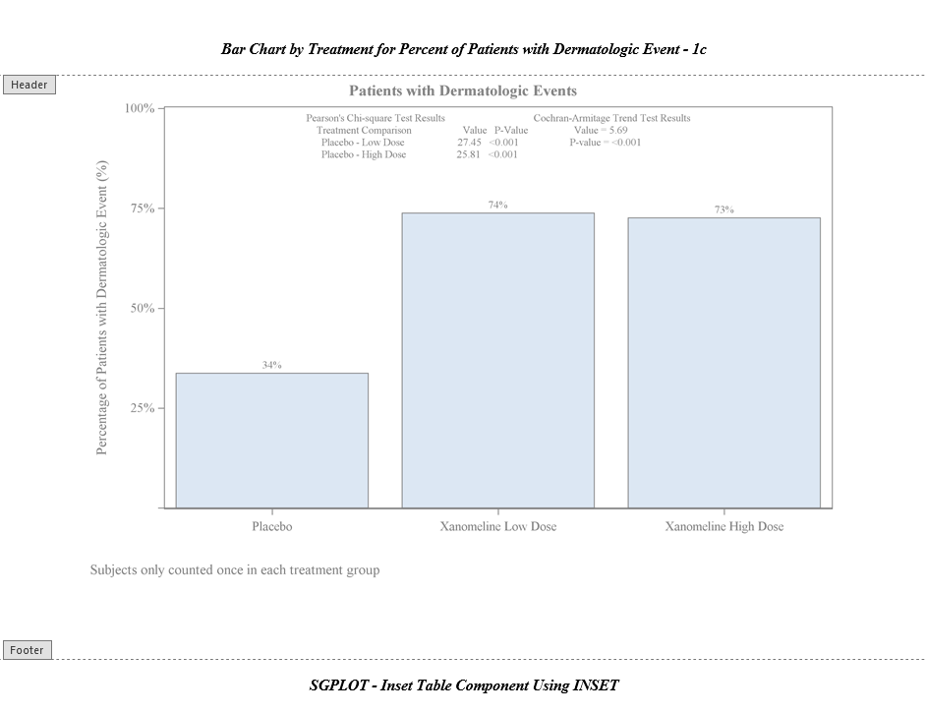
Step 3: Embedding a Table Using INSET

Slide 19
Exercise 3a - Using SGPLOT INSET
proc sgplot data = OUTD.TRTPCT pad = (top=5% bottom=5%) sganno = insidetf;
/* format and axis statements */
vbar TRTAN / response = PCT_ROW
datalabel = PCT_ROW;
inset "Pearson's Chi-square Test Results
Cochran-Armitage Trend Test Results"
" Treatment Comparison Value P-Value
Value = &cmstat"
" Placebo - Low Dose &valuechi054 &pchi054 P-value = &cmpvalue"
" Placebo - High Dose &valuechi081 &pchi081"/
textattrs = (size = 8pt) position = top;
run;
ods rtf close;
ods pdf close;
Notes:
Josh
<< Open Exercise3a – use INSET statement to build the table that is embedded within the wall area --- Maybe have them adjust the spacing and change the attributes. >>
NOT shown is annotate data step.
NOTE that the spacing in the INSET is important so that it appears correct in the output. The pink represents blank spaces. There are 4 sets of statements within the INSET. The first line has 35 spaces between the first part of the line and the second. For the next three lines you will need to play around to get the alignment right.
ANIMA1: Here is what it would look like in a SAS editor if you had it each line on one line.

Slide 20
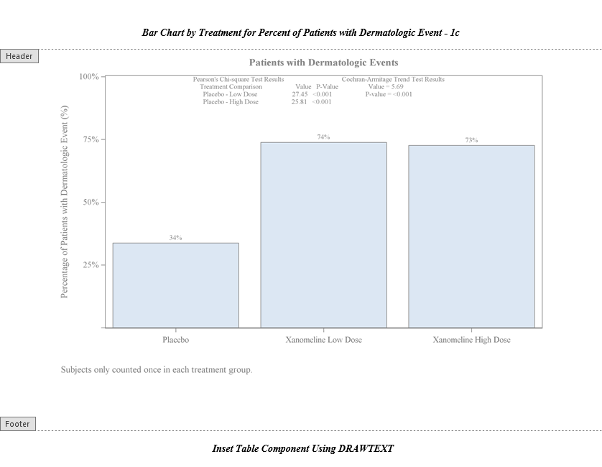
Step 3: Embedding a Table Using DRAWTEXT

Slide 21
Exercise 3b - Using GTL DRAWTEXT
proc template;
define statgraph recrgrphb;
begingraph / border = false;
entrytitle "Patients with Dermatologic Events";
entryfootnote halign = left "Subjects only counted once in each treatment group.";
layout overlay / /* axis options */;
barchart x = TRTAN y = PCT_ROW / orient = vertical
barlabel = true;
/* drawtext statements */
endlayout;
endgraph;
end;
run;
Notes:
Richann
For this next bit we are going to use the DRAWTEXT statement within the OVERLAY to build the table within the graph.
DRAWTEXT statements shown on next slide

Slide 22
Exercise 3b - Using GTL DRAWTEXT
drawtext textattrs = (size = 8pt) "Pearson's Chi-square Test Results
Cochran-Armitage Trend Test Results"
/ x = 20 y = 99 width = 75 widthunit = percent
xspace = wallpercent yspace = datavalue anchor = left;
drawtext textattrs = (size = 8pt) " Treatment Comparison
Value P-Value Value = &cmstat"
/ x = 20 y = 96 width = 75 widthunit = percent
xspace = wallpercent yspace = datavalue anchor = left;
drawtext textattrs = (size = 8pt) " Placebo - Low Dose
&valuechi054 &pchi054 P-value = &cmpvalue" / x = 20 y = 93 width = 75 widthunit = percent
xspace = wallpercent yspace = datavalue anchor = left;
drawtext textattrs = (size = 8pt) " Placebo - High Dose
&valuechi081 &pchi081"
/ x = 20 y = 90 width = 75 widthunit = percent
xspace = wallpercent yspace = datavalue anchor = left;
Notes:
Richann
DRAWTEXT allows you to indicate exactly what you want displayed and where you want it displayed. You would need to specify the font size and the exact location in the graph of where the text is to be placed. This is where understanding the DRAWSPACE comes in handy. Notice that we use options like XSPACE and YSPACE. XSPACE uses WALLPERCENT and we have a value of 20. So, we are starting at 20% of the wall on the X axis. The ANCHOR option is telling us where to anchor the text box. We are anchoring it on the left at the 20% mark along the X axis.
For YSPACE we use DATAVALUE and for the first line we are at 99. The Y axis goes from 0 to 100 which indicates we are going to be at the top of the graph.
<< Open Exercise3b – Run the code … Notice that like the INSET for SGPLOT the spacing is important to get things to line up --- adjust the spacing and change the attributes, e.g., change anchor to right for one of the statements >>

Slide 23
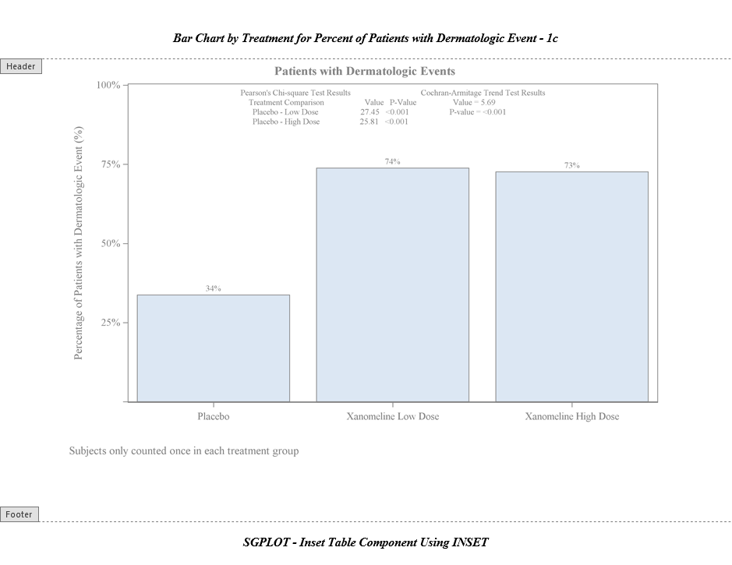
Step 3: Embedding a Table Using GRIDDED
Notes:
Richann
Both techniques required us to make sure the alignment was right with the use of a lot of spaces. Let’s try another approach.

Slide 24
Exercise 3c - Using GTL GRIDDED Layout
proc template;
define statgraph recrgrphb;
mvar valuechi054 pchi054 valuechi081 pchi081 cmstat cmpvalue;
begingraph / border = false;
entrytitle "Patients with Dermatologic Events";
entryfootnote halign = left "Subjects only counted once in each treatment group.";
layout overlay / /* axis options */;
barchart x = TRTAN y = PCT_ROW / orient = vertical
barlabel = true;
/* GRIDDED layout */
endlayout;
endgraph;
end;
run;
Macro variables that are declared using MVAR will resolve to a string where macro variables declared with NMVAR will convert to a numeric token. With (N)MVAR the macro variable is resolved at execution rather than a compile time.
Notes:
Richann
In this example, we demonstrate two things. Nested layouts and MVAR. Let’s talk about the nested layout. Shown here you see that within LAYOUT OVERLAY we have a comment indicating that we are going to use a GRIDDED layout. The code is shown on the next slide, and we will get to that. The main thing is that we are nesting it within the OVERLAY.
Before I show you the nested layout, I want to explain this new concept. MVAR.. MVAR statement indicates the macro variables that can be referenced within the template definition. In this example, it will be used to create the embedded table.
The advantage of using MVAR or MVARN within PROC TEMPLATE is that you don’t need to embed the definition within a macro in order for it to use the macro variables. While you can still use macro variables within the template definition, it requires that the macro variables be defined. Therefore, if the template definition is compiled and saved in the template store, then it cannot reference macro variables with the ampersand (&). The symbols that reference the macro variables resolve at execution rather than resolve at compilation. Resolving at execution rather than at compilation means that your macro variables can be created after your PROC TEMPLATE code. For example, if CMSTAT was not listed in the MVAR statement and we replace CMSTAT with “&CMSTAT” in the template definition and compile the template definition, we would get a WARNING message indicating that CMSTAT not resolved.
To see how this works, close your SAS session and start a fresh session and open Exercise 3c. Don’t run anything yet. Go to the PROC TEMPLATE portion and delete CMSTAT on the MVAR statement.

Slide 25
Using GTL GRIDDED Layout
With GRIDDED layout you specify the number of columns or rows. Default is 1 if not specified.
layout gridded / columns = 4 order = rowmajor autoalign = (top);
entry "Pearson's Chi-square Test Results";
entry " ";
entry " ";
entry "Cochran-Armitage Trend Test Results";
entry " Treatment Comparison";
entry "Value";
entry "P-value";
entry " Value = " cmstat;
entry " Placebo - Low Dose";
entry valuechi054;
entry pchi054;
entry "P-value = " cmpvalue;
entry " Placebo - High Dose";
entry valuechi081;
entry pchi081;
endlayout;
Specify the order in which the grid is filled. ROWMAJOR fills each column before moving to next row.
If a specific cell in the table should be left null, then a blank entry line should be created.
Macro variables specified with MVAR(N) are referenced. Note they are referenced without & symbol.
Notes:
Richann
Change CMSTAT to “&CMSTAT” and ONLY run the PROC TEMPLATE portion. You get a WARNING message about CMSTAT not found. Now run the entire program. The message is gone because the SETUP.sas creates the macro variable and puts it in the symbol table to be referenced. Thus, if you use the & notation for macro variables, it requires that either the template definition be encased in a macro definition or the macro variable already defined.
With PROC TEMPLATE, we can circumvent this with MVAR or NMVAR that way we can save the template definition in the template store for future use.
Now that we played around with the macro variables and understand the difference between MVAR and & reference, let’s turn our attention back to the nested layout. As with most things in PROC TEMPLATE, there are options that help to control what the grid will look like. Here we specify that we want 4 columns and that we want the columns filled out by ROW. So, we will complete a row before moving to the next one. We also want this grid at the top.
Each ENTRY represents a cell in the grid. If there are blank cells, then those are indicated as shown here. Note that the macro variables that were specified on the MVAR do not have &. This is definitely easier than trying to align with a bunch of spaces.

Slide 26
Adding Table Outside of Graph

Slide 27
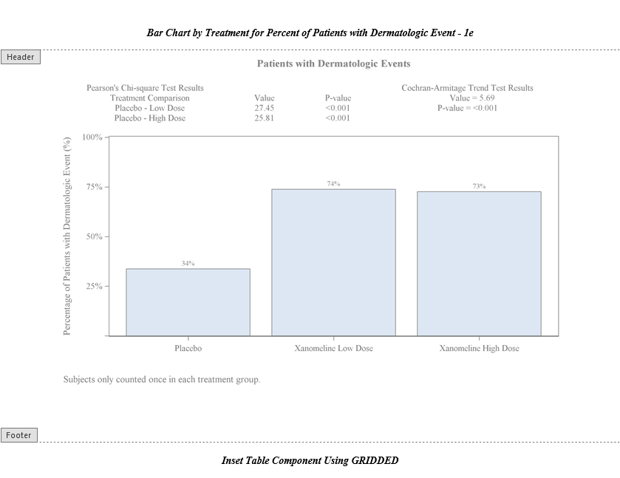
Step 4: Adding Table Outside Graph

Slide 28
Exercise 4 - Using GTL GRIDDED Layout with LATTICE
proc template;
define statgraph recrgrphb;
mvar valuechi054 pchi054 valuechi081 pchi081 cmstat cmpvalue;
begingraph / border = false;
entrytitle "Patients with Dermatologic Events";
entryfootnote halign = left "Subjects only counted once in each treatment group.";
layout lattice / rows = 2 rowweights = (.2 .8);
/* GRIDDED layout */
layout overlay / /* axis options */;
barchart x = TRTAN y = PCT_ROW / orient = vertical barlabel = true;
endlayout;
endlayout;
endgraph;
end;
run;
LATTICE allows you to split area into different sizes based on your needs. You can split into rows or columns or a combination of rows and columns.
Notes:
For our last exercise, we are going to move the table outside of area where the bar chart resides.
With PROC TEMPLATE, there are different layouts. We talked about OVERLAY and GRIDDED. Now we introduce the LATTICE. This allows us to split the graph into different sizes based on our needs.
In the previous exercise, the GRIDDED layout was nested within OVERLAY. Here the GRIDDED layout can be moved to outside of the OVERLAY with both the GRIDDED and OVERLAY layouts being nested within the LATTICE. LATTICE allows you to determine the weight for each cell. Since we want these to be displayed in rows, we indicate the number of rows with the first row using 20% of the graph area and the second row using 80% of the graph area.
The GRIDDED layout is moved to above the OVERLAY layout since we want it to appear above the graph.
<< Open Exercise 4 … switch row weights to .8 and .2 and move the GRIDDED layout below the OVERLAY layout >>

Slide 29
Conclusion
What have we learned?

Slide 30
SGPLOT vs. GTL
SGPLOT
GTL
Advantages:
Simple syntax
Ideal for simple graphs
Inset table directly into graph
Disadvantages:
Hard to have titles and footnotes within the graph area and outside the graph area
Can’t place a table outside of the graph
Advantages:
Embed titles and footnotes within graph area and outside the graph area
Ideal for complex graphs
Different techniques to inset table directly into graph
Disadvantages:
Complex syntax

Slide 31
Richann Jean Watson
richann.watson@datarichconsulting.com
http://www.datarichconsulting.com/
https://www.linkedin.com/in/richann-watson-31435422/
https://www.linkedin.com/company/datarich-consulting/
Josh M. Horstman
josh@nestedloopconsulting.com

Slide 32
References and Recommended Reading
Haworth, L. (2006). PROC TEMPLATE: The Basics. Proceedings of SUGI 31. San Francisco: SUGI. Retrieved from https://support.sas.com/resources/papers/proceedings/proceedings/sugi31/112-31.pdf
Heath, D. (2018). Diving Deep into SAS® ODS Graphics Styles. Proceedings of PharmaSUG. Seattle: PharmaSUG. Retrieved from https://www.pharmasug.org/proceedings/2018/DV/PharmaSUG-2018-DV02.pdf
Kriss Harris, R. W. (2020). SAS® Graphics for Clinical Trials by Example. Cary: SAS Institute Inc.
Kuhfeld, W. (2015). Advanced ODS Graphics Examples. Cary: SAS Institute Inc. Retrieved from https://support.sas.com/documentation/prod-p/grstat/9.4/en/PDF/odsadvg.pdf
Kuhfeld, W. (2016). Basic ODS Graphics Examples. Cary: SAS Institute Inc. Retrieved from http://support.sas.com/documentation/prod-p/grstat/9.4/en/PDF/odsbasicg.pdf
Matange, S. (2013). Getting Started with the Graph Template Language in SAS®. Cary: SAS Institute Inc.
Matange, S. (2016). Clinical Graphs Using SAS®. Cary: SAS Institute Inc.
Sanjay Matange, D. H. (2019). Create A Combined Graph of Tumor Data. Proceedings of SAS Global Forum. Dallas: SAS Institute Inc. Retrieved from https://www.sas.com/content/dam/SAS/support/en/sas-global-forum-proceedings/2019/3143-2019.pdf

Slide 33
References and Recommended Reading
SAS Institute Inc. (2023, Jul 19). About the Drawing Space and Drawing Units. Retrieved Dec 2023, from SAS® 9.4 and SAS® Viya® 3.5 Programming Documentation: https://documentation.sas.com/doc/en/pgmsascdc/9.4_3.5/grstatgraph/n1jn4duv8s510xn1y2nlbefm0p46.htm
SAS Institute Inc. (2023, Jul 19). DRAWTEXT Statement. Retrieved Dec 2023, from SAS® 9.4 and SAS® Viya® 3.5 Programming Documentation: https://documentation.sas.com/doc/en/pgmsascdc/9.4_3.5/grstatgraph/n0mngqruucae70n17d07ugtknu3g.htm#n1p67wdoi189fkn16c8vkq1wnqzp
SAS Institute Inc. (2023, Jul 19). ENTRYTITLE Statement. Retrieved Dec 2023, from SAS® 9.4 and SAS® Viya® 3.5 Programming Documentation: https://documentation.sas.com/doc/en/pgmsascdc/9.4_3.5/grstatgraph/n0zp1mg0ard2dan17sohm8jb773n.htm
SAS Institute Inc. (2023, Jul 19). SGPLOT Procedure. Retrieved Dec 2023, from SAS® 9.4 and SAS® Viya® 3.5 Programming Documentation: https://documentation.sas.com/doc/en/pgmsascdc/9.4_3.5/grstatproc/n0yjdd910dh59zn1toodgupaj4v9.htm
Watson, R. (2019). Great Time to Learn GTL: A Step-by-Step Approach to Creating the Impossible. Proceedings of SAS Global Forum. Dallas: SAS Institute Inc. Retrieved from https://www.sas.com/content/dam/SAS/support/en/sas-global-forum-proceedings/2019/3170-2019.pdf

